Slide 1

Cheating in CS:GO
Kfir Back 325345064
I Chose this dataset, because anti-cheat is a subject in cyber security, And because CS:GO is a video game that lacks an anti-cheat.

Slide 2
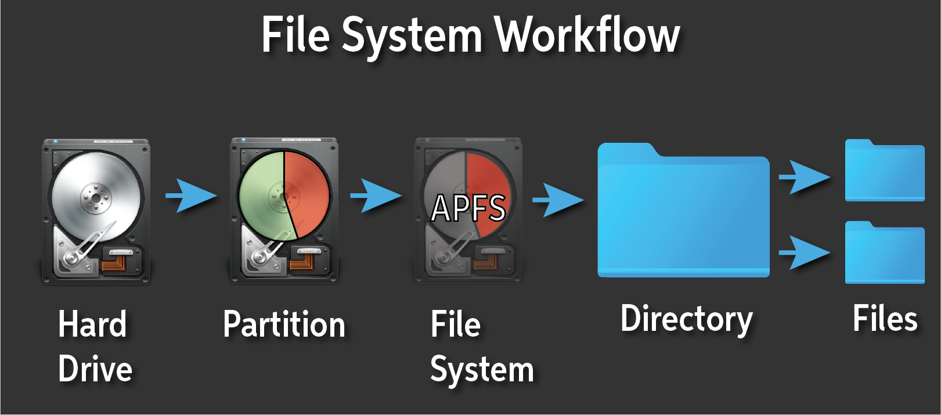
Systems stage
File system
Data includes 10 000 clean players and 2 000 cheaters. Data is in shape (players, 30, 192, 5).
30 = number of engagements per player (always 30)
192 = timesteps, ticks around the engagement (5 seconds before, 1 second after)
5 = input variables: AttackerDeltaYaw, AttackerDeltaPitch, CrosshairToVictimYaw, CrosshairToVictimPitch, Firing
Firing is 1 or 0 and the rest are normal floats (all the data is stored in float32 numpy arrays).
I found it on Kaggle

Slide 3
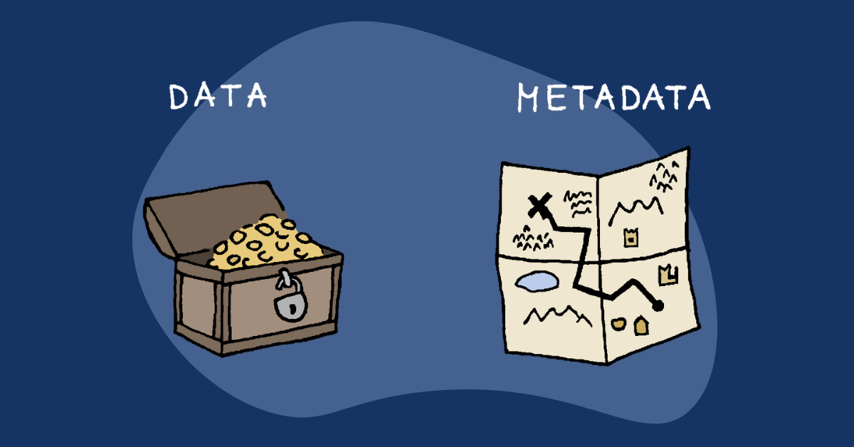
Meta data
Data size - (12000, 30, 192, 5)
Missing data - None
Special values - None

Slide 4
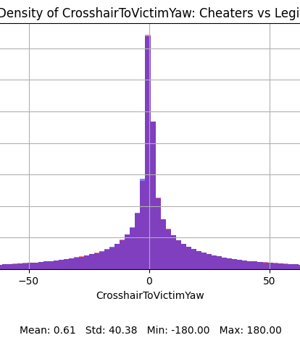
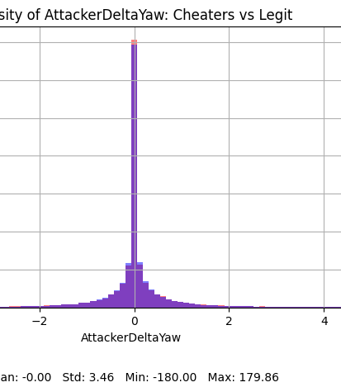
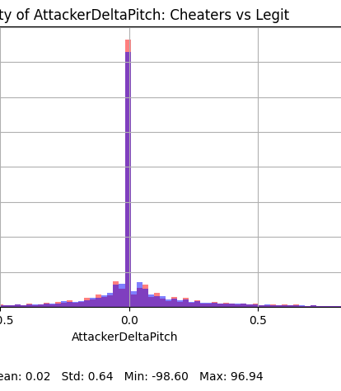
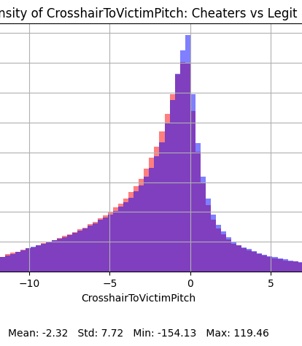
Data Statistics
This doesn’t tell us a lot. It’s hard to see any differences. So, I studied these statistics over the scale of time.

Slide 5
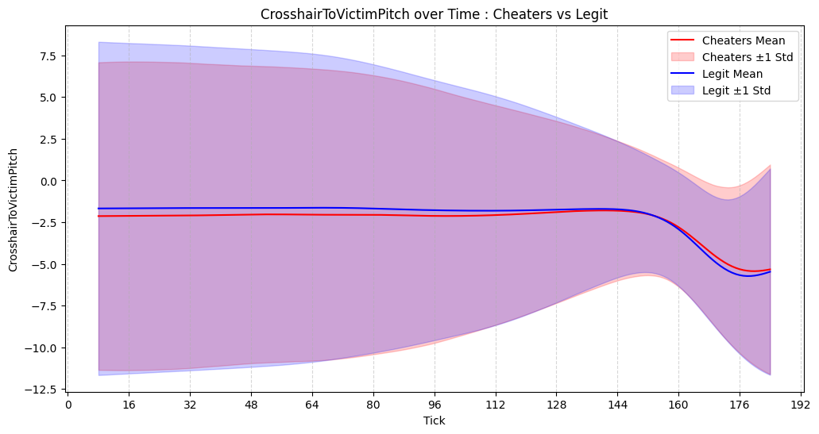
Data Statistics
First thing we can notice is that the pitch of the cheaters is generally lower than the legit players before shooting, because they don't have to aim as well as non cheaters (Default should be 0, but players tend to walk looking a bit down, so that if they dont hit the head they still hit the body). To add to that we can notice that the cheaters pitch after shooting is higher, that may be because their cheats know how to compensate for recoil better.

Slide 6
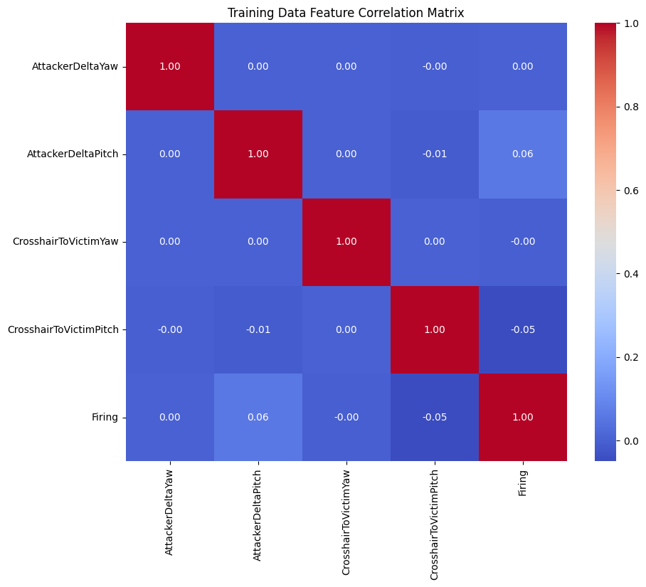
Correlation
As you can see there is no correlation between the features.

Slide 7

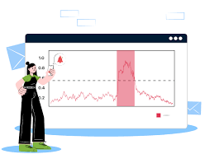
Abnormality detection
I Chose to use Isolation forest because I believe it’s the most fitting in this dataset.
I got some anomalies, so I decided I’ll add another feature which is the score that they got.

Slide 8
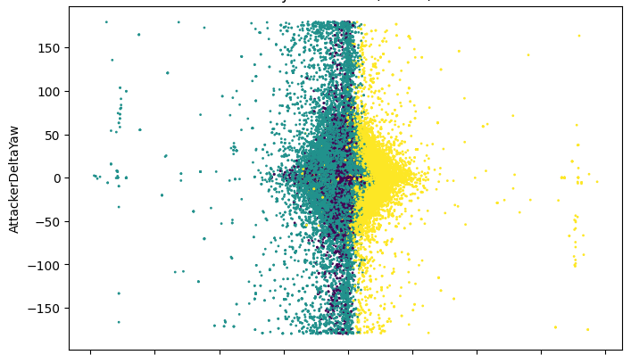
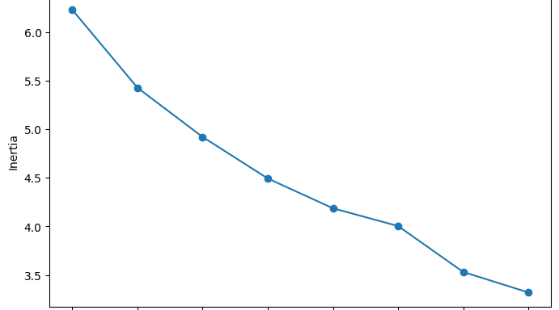
Clustering
The Elbow Method graph shows that inertia decreases rapidly up to 3–4 clusters, after which improvements become minor.
This indicates that 3 or 4 clusters capture most of the natural grouping in the data.
The cluster visualization confirms this, showing clear separation between groups with minimal overlap.
Adding more clusters beyond this would increase complexity without significant benefit.

Slide 9
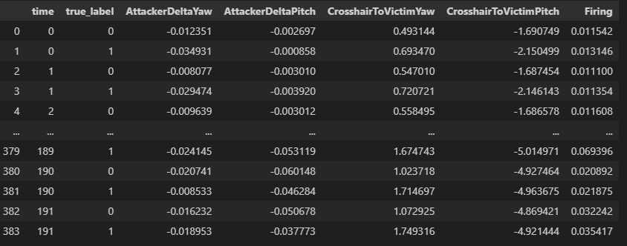
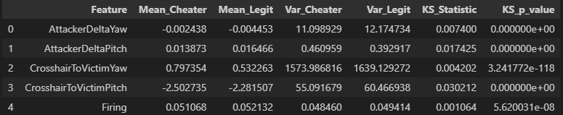
Segment analysis
Features:
Cheaters show slightly different aiming behaviour compared to legit players.
CrosshairToVictimYaw/Pitch differences are most notable.
Temporal:
Over time, cheaters consistently maintain tighter crosshair alignment and lower aim variability. (Shown in the variance also)
Legit players show more natural fluctuations across match ticks.
Domain Knowledge:
In CS:GO, unusually stable aim and perfect target alignment are red flags for cheating.
Temporal consistency and precision support the segmentation findings.

Slide 10
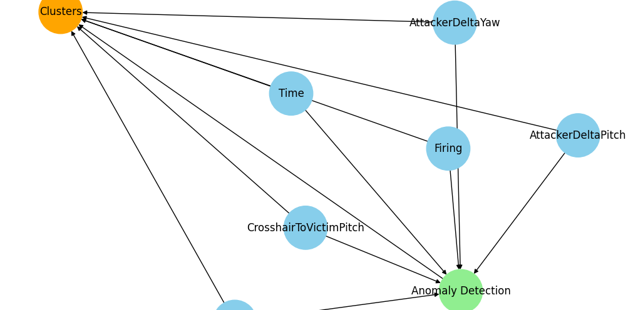
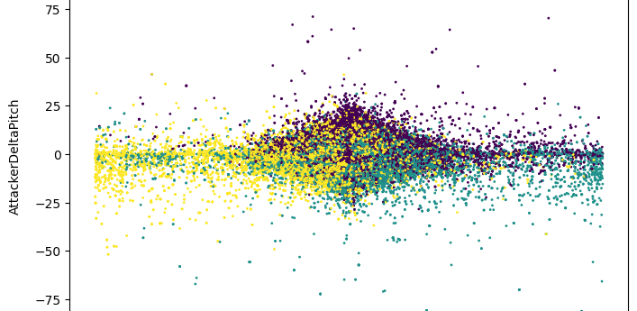
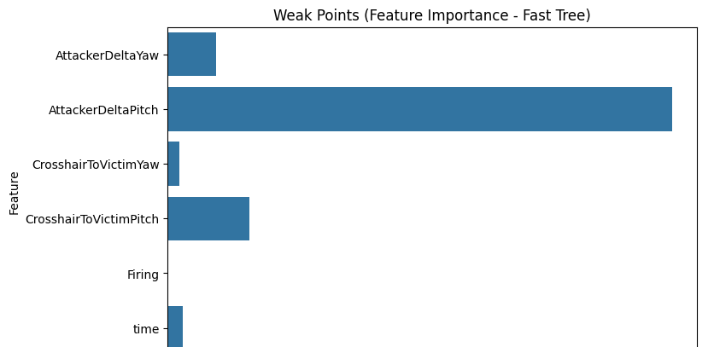
Graphs
Raw gameplay features flow into anomaly detection and directly into clustering.
Detected anomalies help refine player segmentation into distinct behavior groups.
Players are grouped into segments based on aiming behavior.
Clusters highlight distinct aiming patterns and potential cheating behavior.
Vertical aiming behavior is the key weak point for detecting cheaters.

Slide 11
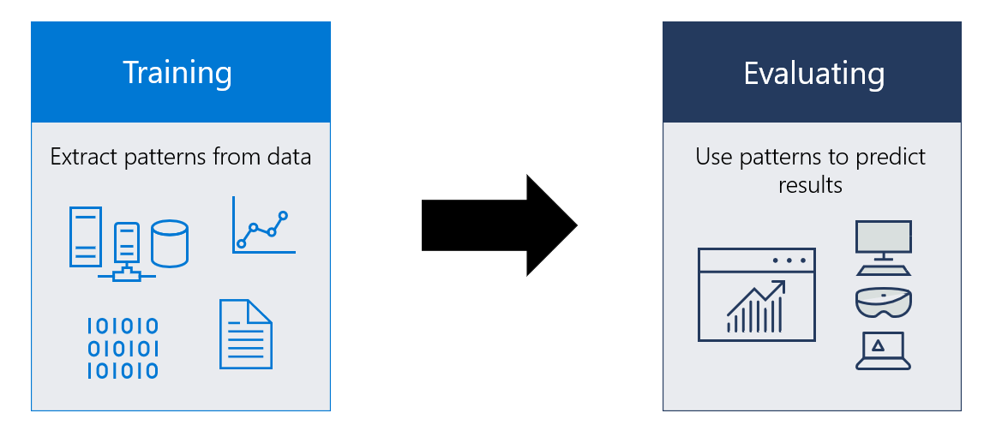
Models
Why Neural Network (NN) and Why It’s the Best Choice
Captures Complex Patterns: Cheating behavior in CS:GO isn’t just based on static values—it involves temporal and nonlinear relationships between aiming, crosshair alignment, and firing patterns. Neural networks can model these complex feature interactions better than Logistic Regression or Decision Trees.
Preserves Temporal Dynamics: Unlike tree models that treat each sample independently, the NN can process the entire 30-tick sequence, learning how player behavior evolves over time—a key aspect of cheat detection.
Improved Performance: Early tests showed Logistic Regression improved over Decision Trees but still had low recall for cheaters. Neural networks, with multiple hidden layers and nonlinear activations, can better separate subtle cheating patterns from legitimate play.

Slide 12
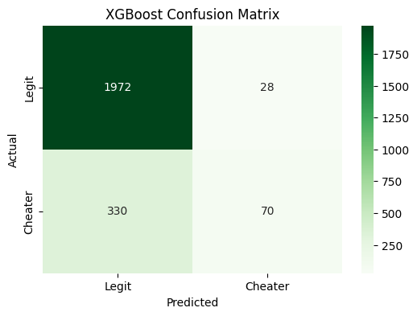
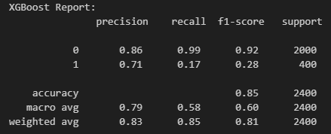
Reporting
The XGBoost model achieved an overall accuracy of 85%, performing very well at detecting legit players (99% recall) but struggling to identify cheaters (17% recall). This imbalance is largely due to the dataset having many more legit samples (2000) than cheaters (400), leading the model to favor predicting legit labels. As shown in the confusion matrix, 330 cheaters were misclassified as legit while only 70 were correctly flagged.

Slide 13

Improve
I believe that with more informative features—such as reaction time, headshot percentage, and gun recoil control—the model could achieve significantly better performance. Additionally, having access to a larger and more balanced dataset of cheaters would improve training and reduce prediction bias.

Slide 14
Summary
The project successfully builds an anti-cheat model for CS:GO using multiple approaches, and XGBoost. The XGBoost model achieved the best performance with 85% accuracy, performing well in detecting legit players (99% recall) but struggling to identify cheaters (17% recall). Feature importance analysis shows that vertical aiming adjustments (AttackerDeltaPitch) and CrosshairToVictimPitch are the most significant indicators of cheating behavior. Outlier detection methods (IQR, Z-score, Isolation Forest) and data visualizations help better understand the dataset’s distribution and potential anomalies.

